Slide 1



Financial Analytics
01
https://github.com/Selvamani6903/Financial-Analysis

Slide 2

Introduction
The Financial Data contain the Total Market value of the company and Sales Quater of the company.Top 420 companies are listed in the given data.
01

Slide 3
Main KPIs
Company Market Captial which help to print the Highest Market capital of comapany which is listed out
Company Sales Quater which is used to print the Highest sales of the company in per quater of 3 months.
Total Market value used to add the sum of market captial of the top companies listed in the data.
02
02

Slide 4
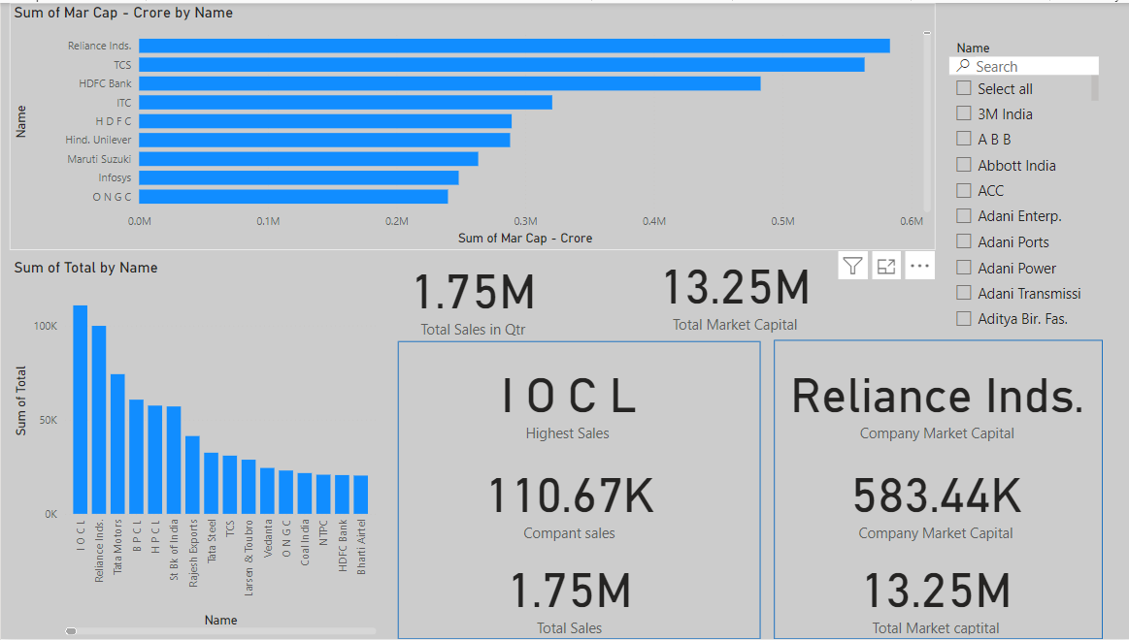
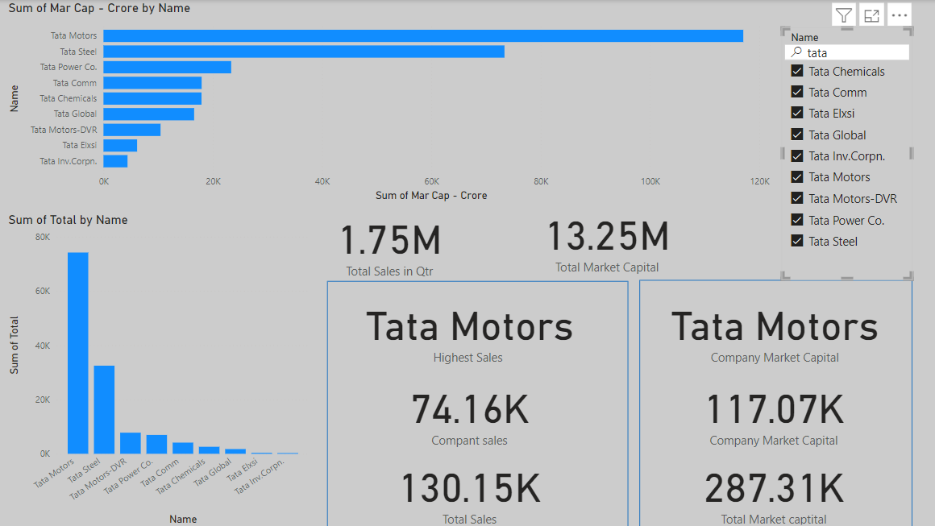
My Design
02

Slide 5

THANKS YOU
https://github.com/Selvamani6903/

